Slide 1
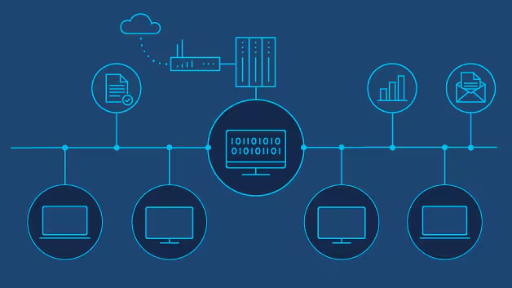
NETWORK PROGRAMMING
GROUP 8
TOPIC: GAME LOBBY SYSTEM

Slide 2
GROUP MEMBERS
Phạm Minh Hiếu
Nguyễn Việt Hưng
Nguyễn Thành Đạt
23BI14166-leader
23BI14188-member
23BI14091-member
Hoàng Minh Quân
Vũ Xuân Thái
Nghiêm Xuân Sơn
Nguyễn Hữu Phương
23BI14371-member
23BI14397-member
23BI14388-member
23BI14362-member

Slide 3
01
02
Topic description
Overall Architecture
03
04
CONTENT
System Features
Representative Code
05
06
Execution Results
Limitations & Proposed Extensions
07
08
Conclusions
Appendix: How to run

Slide 4
1, TOPIC DESCRIPTION
Build: lobby system ⟶ allows multiple players connect to server
Create, join game room by code (6 alphanumeric characters)
Chat in the room, lobby
Monitor player status

Slide 5
2, OVERALL ARCHITECTURE
Client
Server
Using interface (Tkinter)
Connect to server
Send & Receive commands
Manage users, game room
Processes communication between clients

Slide 6
3, SYSTEM FEATURES
Registers & Log in
Public chat & in-room chat
Display current room list
Players status: Online/In Game/ Away
1
2
3
Create Rooms
Generate Random Room Codes
Join the Room by Codes
4
Notify: Players join or leave
Handle minimum 20 users & 5 rooms

Slide 7
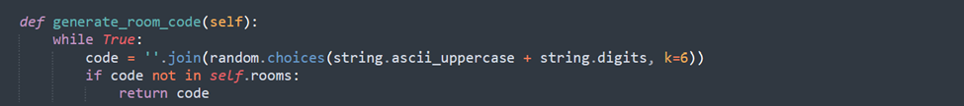
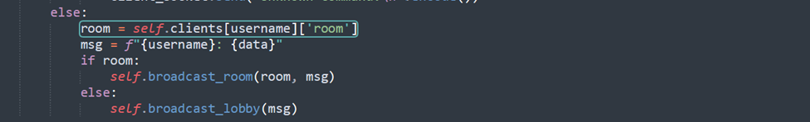
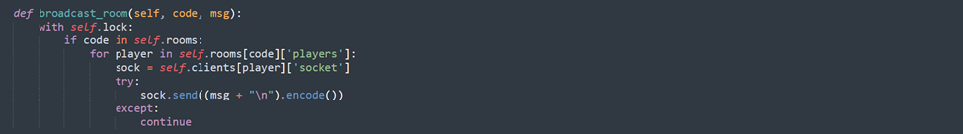
4, REPRESENTATIVE CODE
Some Typical Source Codes
01
Generate Random Room Codes
02
Send Messages in the Room

Slide 8
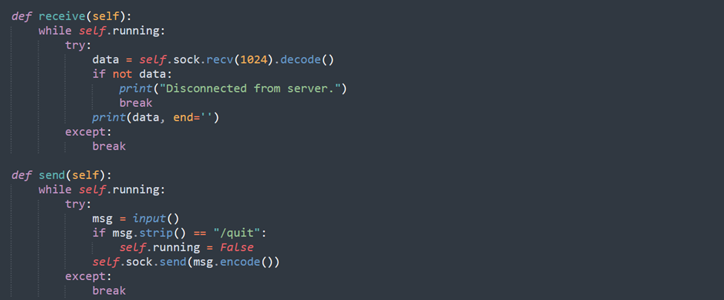
4, REPRESENTATIVE CODE
Some Typical Source Codes
03
Send, Receive, Display messages

Slide 9
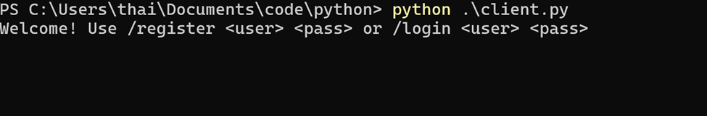
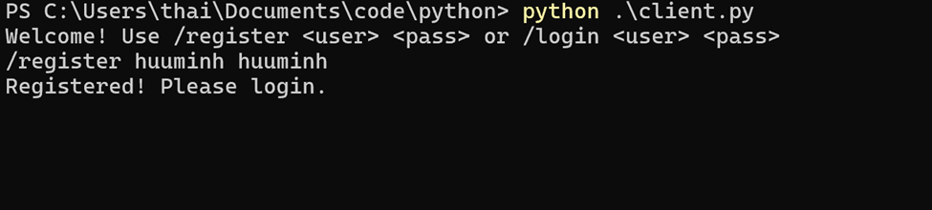
5,EXECUTION RESULTS
5.1, Registration and Login
Interface
Result

Slide 10
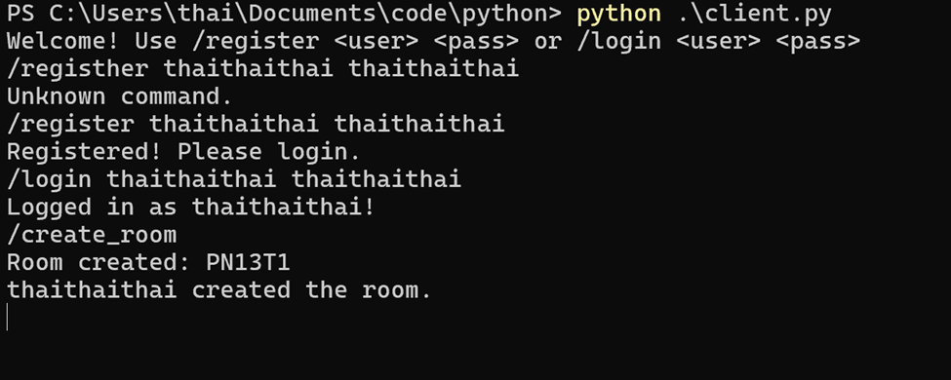
5,EXECUTION RESULTS
5.2, Room Created
Interface & Results

Slide 11
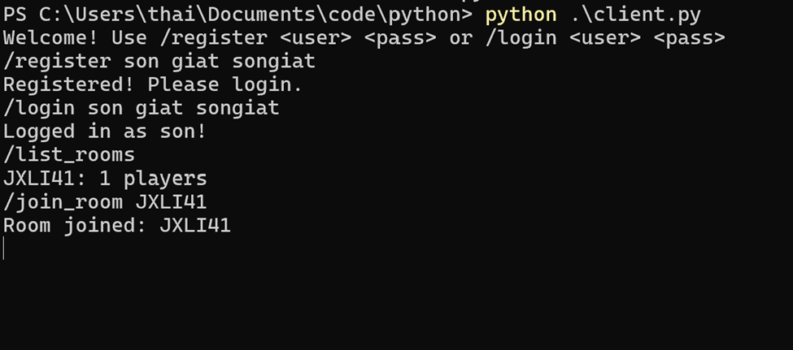
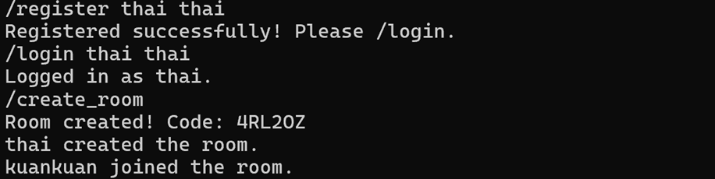
5, EXECUTION RESULTS
5.3, Room joining
Interface
Result

Slide 12
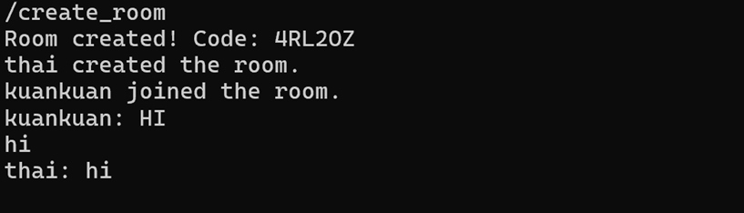
5, EXECUTION RESULTS
5.4, In Room Chat
Interface & Result

Slide 13
6, LIMITATIONS & PROPOSED EXTENSION
Limitations
Extension
Database for users, rooms, chat history
Use TLS/SSL for encryption
Optimizing by asyncio
Update features: invite players, room password
Update GUI
No password authentication
No users data storage
server use threading ⟶limitation resources
no encryption during data transfer

Slide 14


CONCLUSIONS
The Game Lobby System’s requirement:
Supports registration, room creation & joining
Communications between players
Manages status & room data
Expand easily & integrate games into rooms

Slide 15


HOW TO RUN
Running the server
2.Running the clients (run each terminal for each client)
3.Interactions:
Log in, Sign up, create, join the room
Chatting and status management

Slide 16
THANKS FOR WATCHING

